Slide 1
Project 2
Rekha Kondeti
Graduate

Slide 2
Task-1
Discriminant Analysis Classifiers: 'linear', ‘diagLinear’, ’
quadratic’,and ‘diagQuadratic’
Training=70%, Testing=30%

Slide 3
Methods Used
#Splitting data to training and testing:
x_train, x_test, y_train, y_test = train_test_split(p, T, test_size = 0.3, random_state=10)
#feature scaling for LDA:
from sklearn.preprocessing import StandardScaler
sc = StandardScaler()
x_train = sc.fit_transform(x_train)
x_test = sc.transform(x_test)
print(x_train)
print(x_train.shape)
#For LDA:
from sklearn.discriminant_analysis import LinearDiscriminantAnalysis
model = LinearDiscriminantAnalysis()
model.fit(x_train,y_train)
print(model.predict(x_test))
print(model.score(x_test,y_test))
#For DLDA:
clf2 = LinearDiscriminantAnalysis(solver="lsqr", shrinkage=1)
clf2.fit(x_train,y_train)
#For QDA:
from sklearn.discriminant_analysis import QuadraticDiscriminantAnalysis
qda = QuadraticDiscriminantAnalysis()
qda.fit(x_train,y_train)
#For DQDA:
from sklearn.naive_bayes import GaussianNB
gnb = GaussianNB()
gnb.fit(x_train,y_train)
#ROC Curve:
from sklearn.metrics import plot_roc_curve
roc_lda = plot_roc_curve(model, x_train, y_train)
plt.show()
#Confusion Matrix:
from pretty_confusion_matrix import pp_matrix_from_data
pp_matrix_from_data(y_train, y_pred_train,cmap='PuRd')
plt.show()

Slide 4
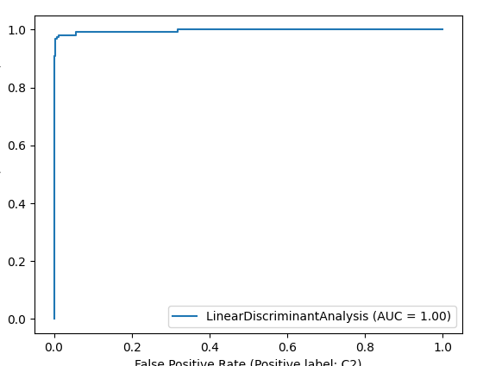
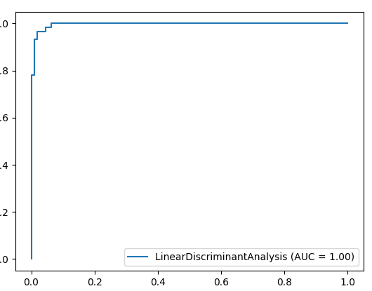
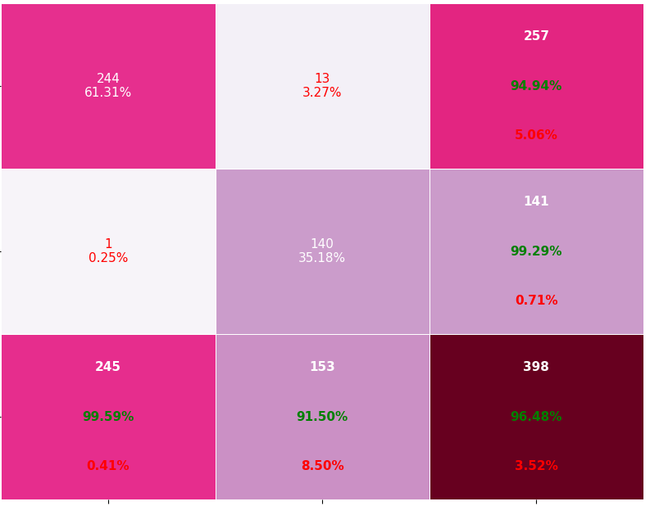
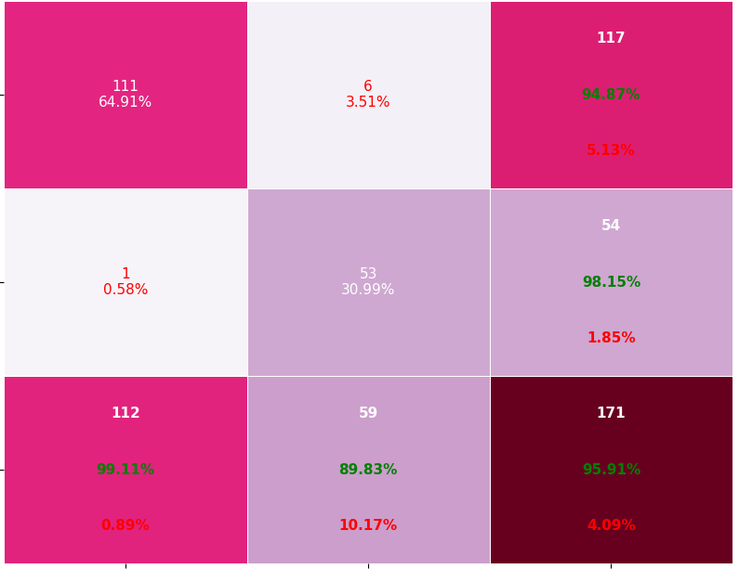
Roc and Classification matrix for LDA
Training:
Testing:

Slide 5
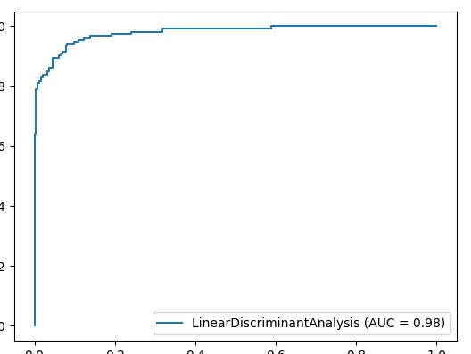
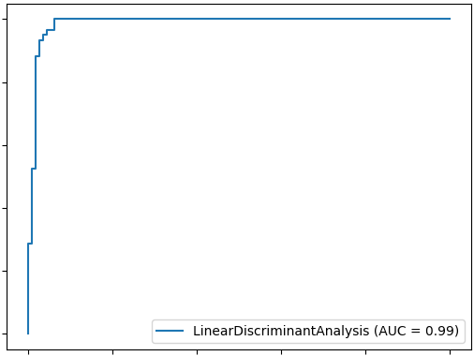
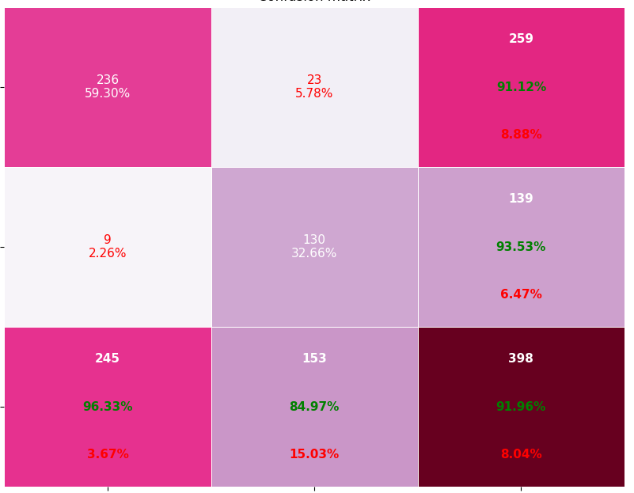
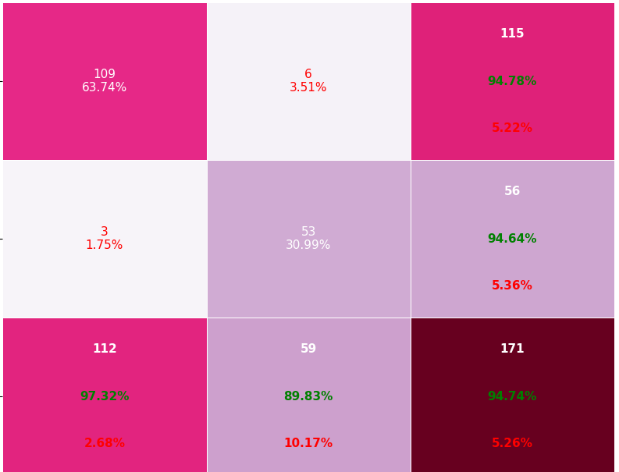
Roc and Classification matrix for DLDA
Training:
Testing:

Slide 6
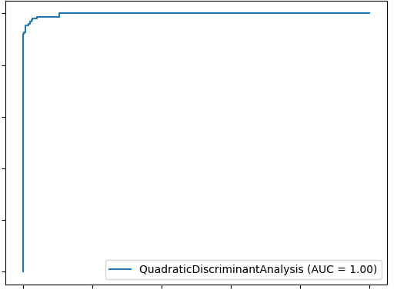
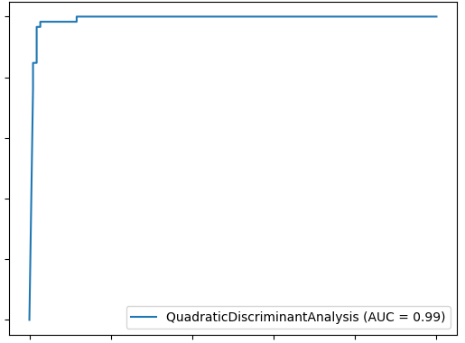
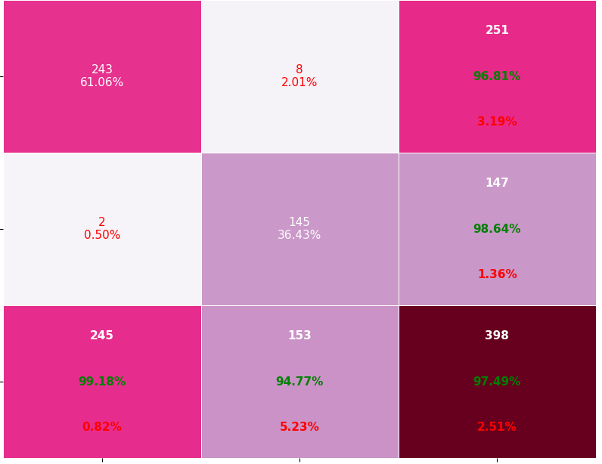
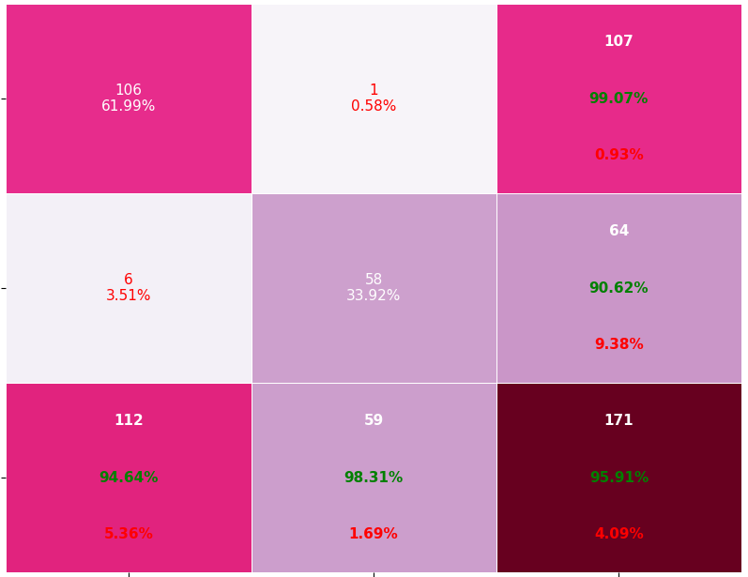
Roc and Classification matrix for QDA
Training:
Testing:

Slide 7
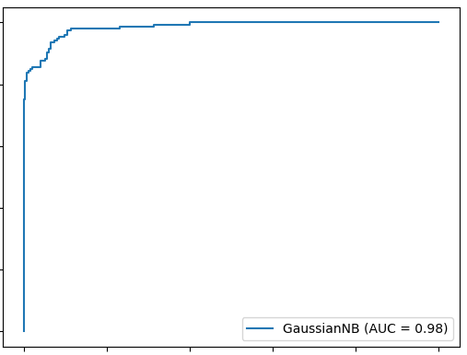
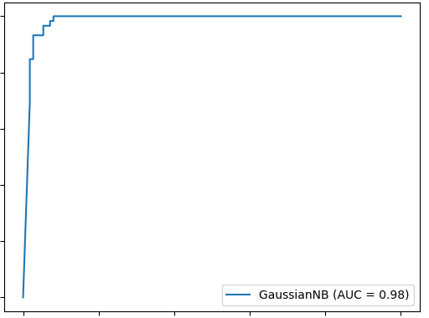
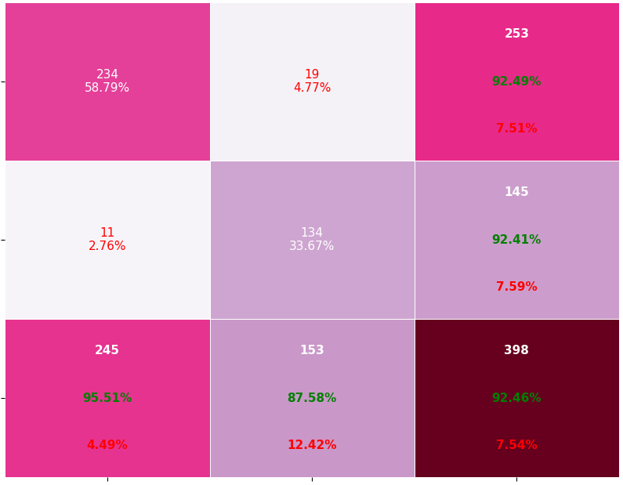
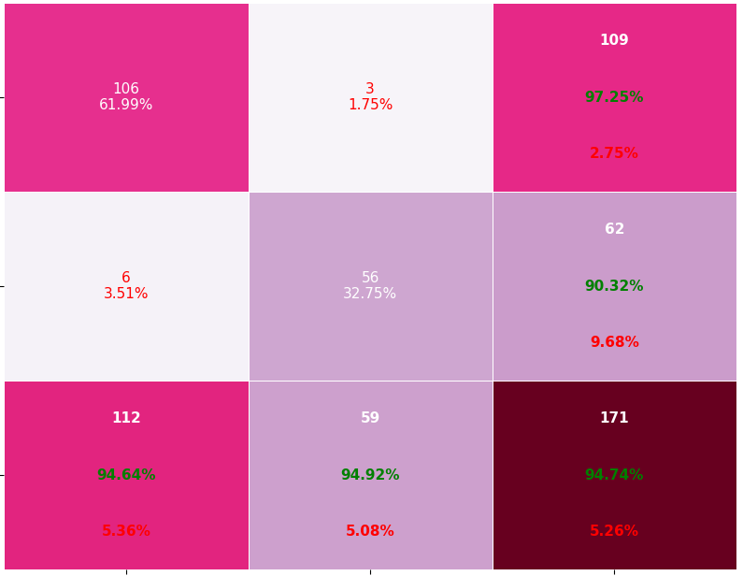
Roc and Classification matrix for DQDA
Training:
Testing:

Slide 8
Observations of TAsk1
For LDA and QDA the AUC’s are approximately equal and hence almost both performs well .
Also, DLDA and DQDA performs well if we can see AUC’s in above slides(approximately equal to 1) as it has less sample size
Although DLDA and DQDA is performing better for high-dimensional data with small sample sizes but does not work that good in real timedue to bias on discriminant scores
As the sample size is small,all the models tend to perform well but this does not happen in real time
If we observe from classification matrix, Overall performance of the models are good as the sensitivity and specificity are good and also type I& type II error are comparatively less as sample size is good.

Slide 9
Task-2
(a)Using PCA reduce dimensinality to get variance 99% and perform
Discriminant Analysis Classifiers: 'linear', ‘diagLinear’, ’
quadratic’,and ‘diagQuadratic’ with new features
(b)Using PCA reduce dimensinality to get variance 99.9% and perform
Discriminant Analysis Classifiers: 'linear', ‘diagLinear’, ’
quadratic’,and ‘diagQuadratic with new features
Plot ROC curves and classification matrix for Training and Testing datasets

Slide 10
a)Method Used for 99% Variance
from sklearn.decomposition import PCA
pca = PCA(0.99)
y=pca.fit(x_train)
print(pca.n_components_)
print('Explained variation per principal component: {}'.format(pca.explained_variance_ratio_))
top 17 components for 99% cumulative:

Slide 11
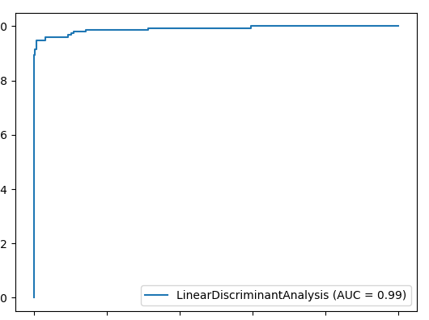
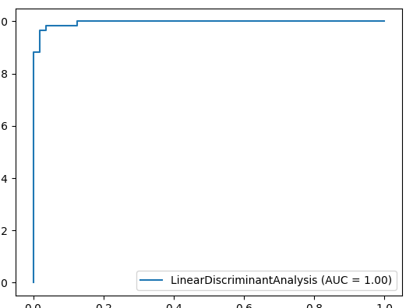
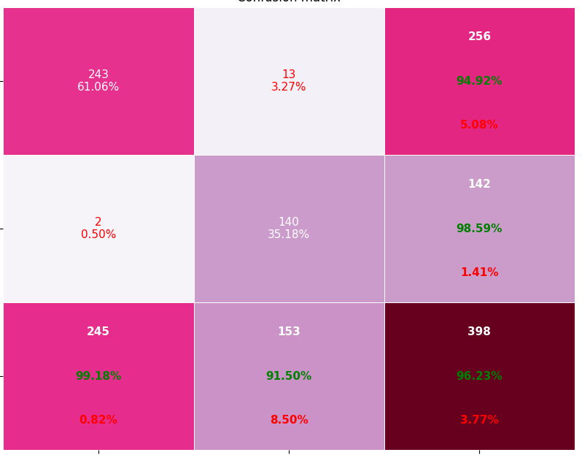
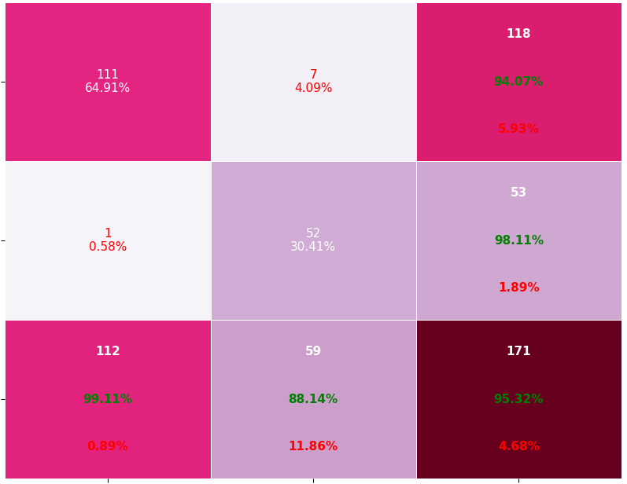
Roc and Classification matrix for LDA
Training
Testing

Slide 12
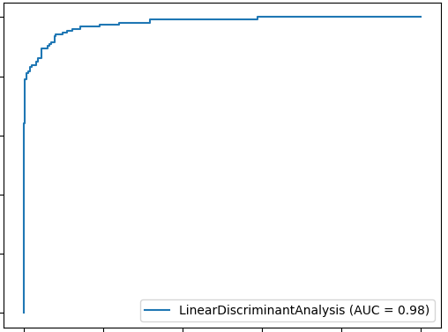
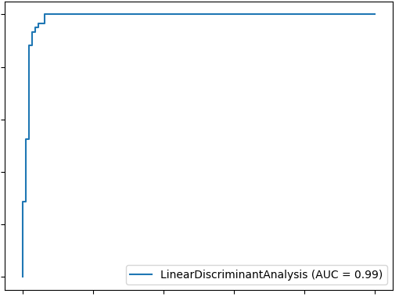
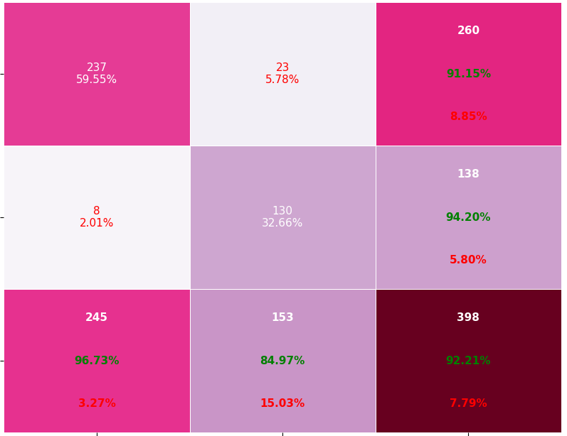
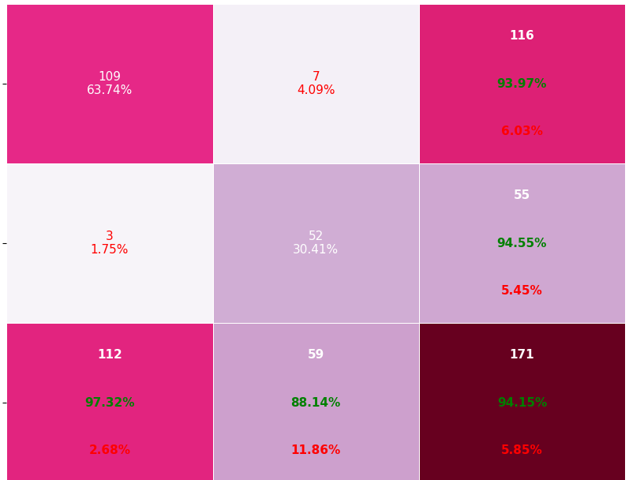
Roc and Classification matrix for DLDA
Training:
Testing:

Slide 13
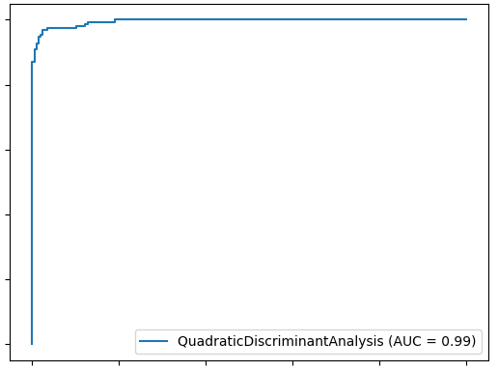
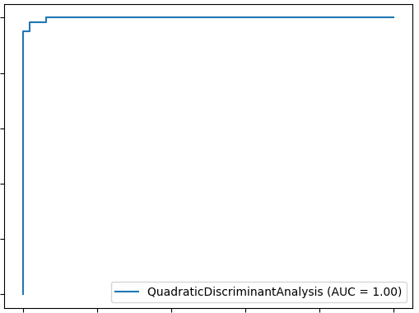
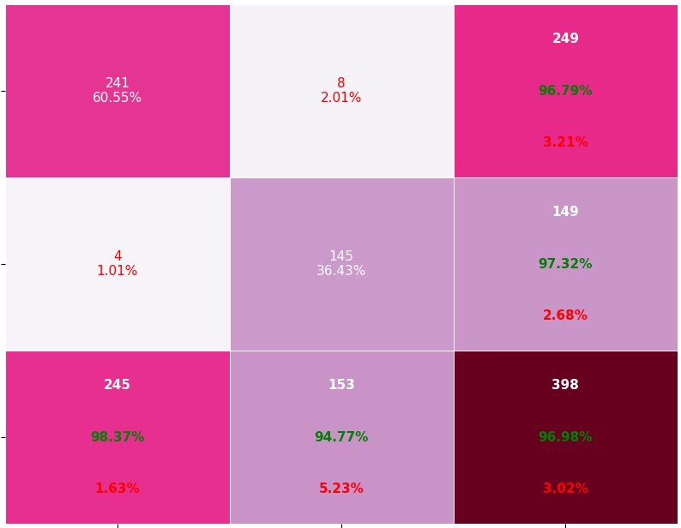
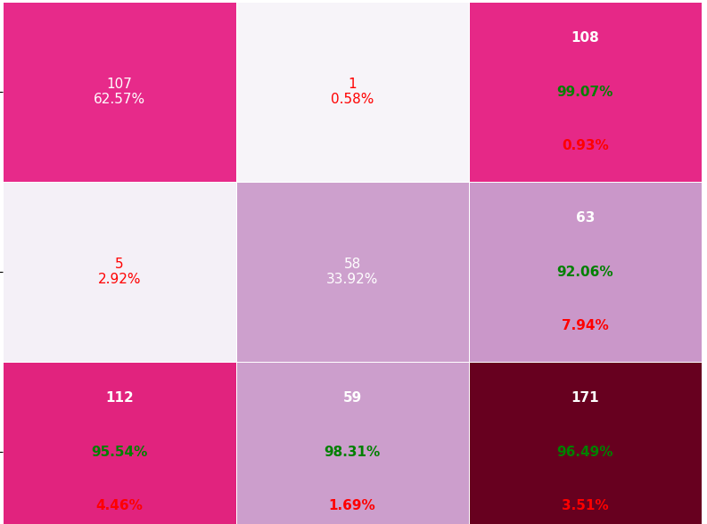
Roc and Classification matrix for QDA
Training:
Testing:

Slide 14
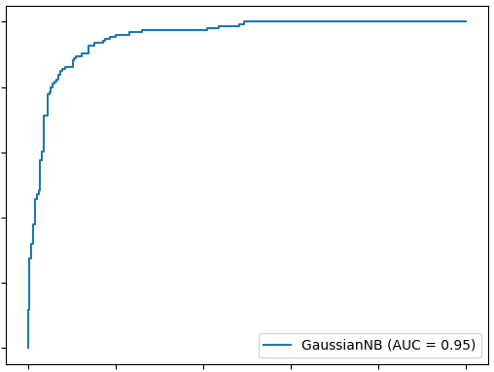
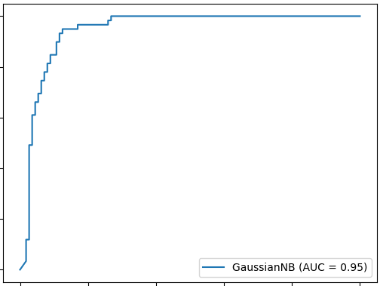
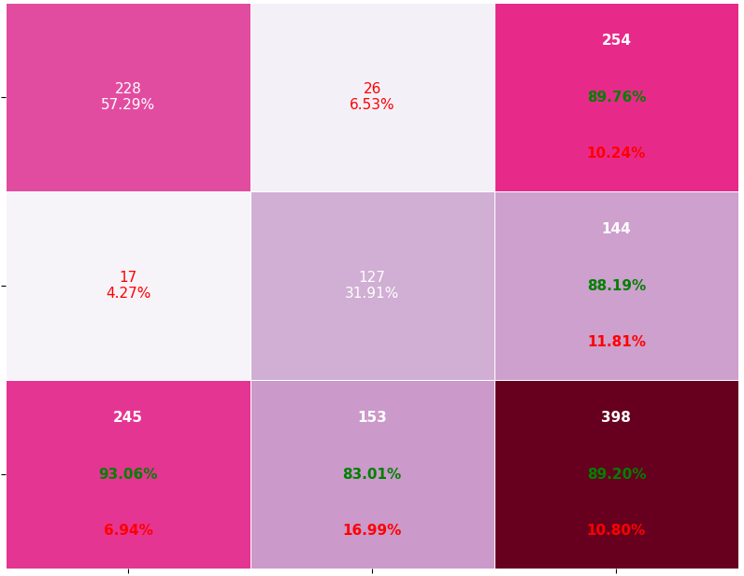
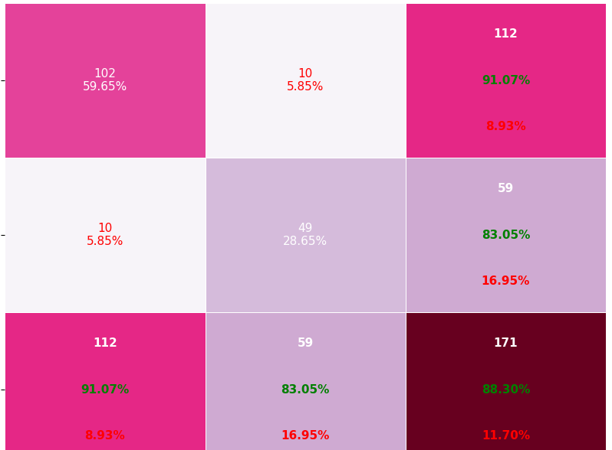
Roc and Classification matrix for DQDA
Training:
Testing:

Slide 15
B)Method Used for 99.9% Variance
pca = PCA(0.999)
Y = pca.fit(x_train)
print(pca.n_components_)
print('Explained variation per principal component: {}'.format(pca.explained_variance_ratio_))
x_test=pca.transform(x_test)
top 24 components for 99.9% cumulative:

Slide 16
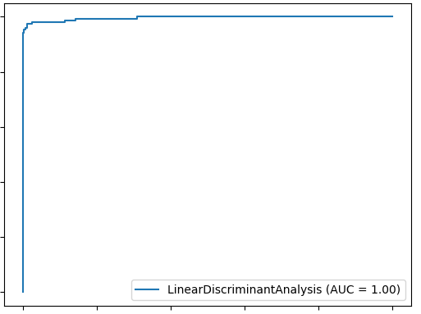
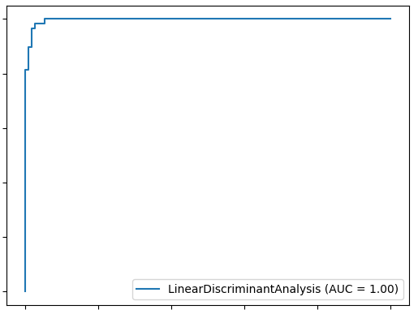
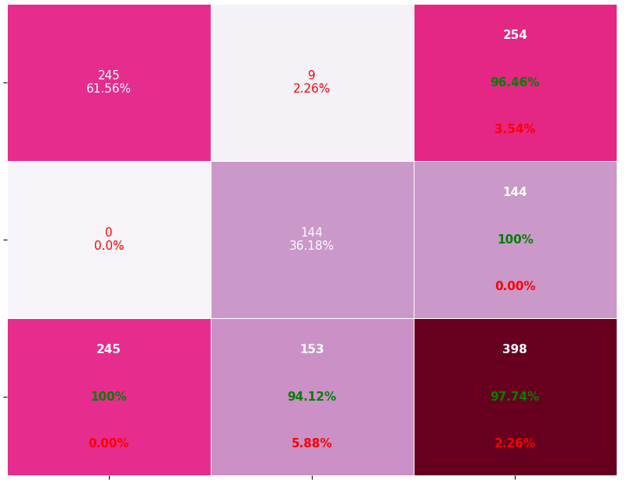
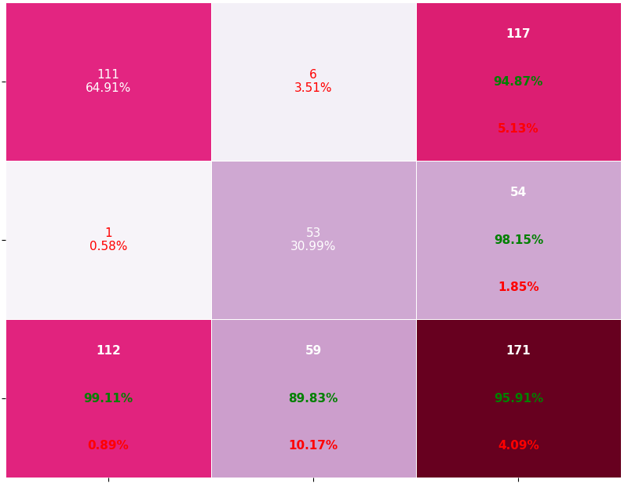
Roc and Classification matrix for LDA
Training:
Testing:

Slide 17
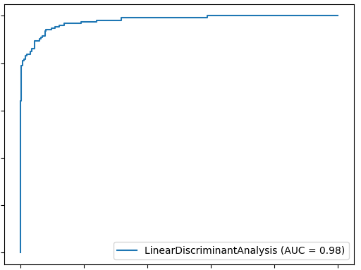
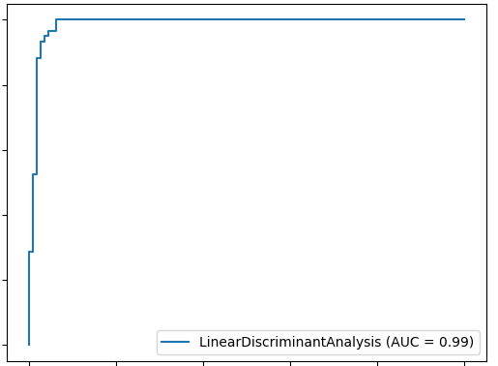
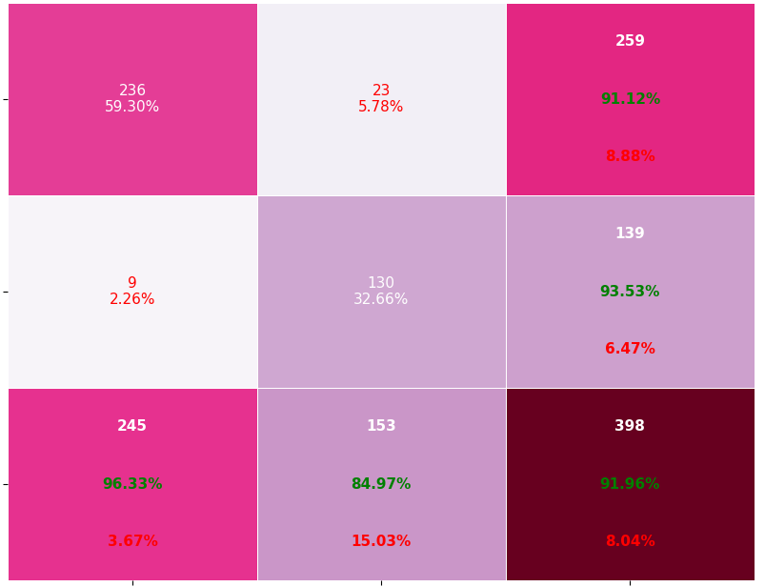
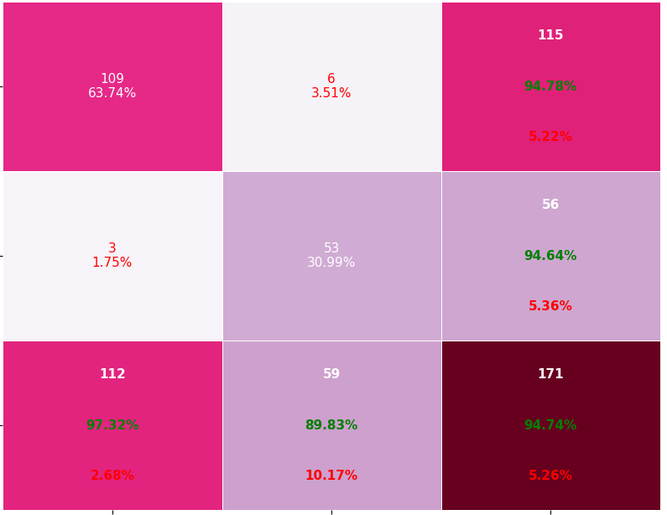
Roc and Classification matrix for DLDA
Training:
Testing:

Slide 18
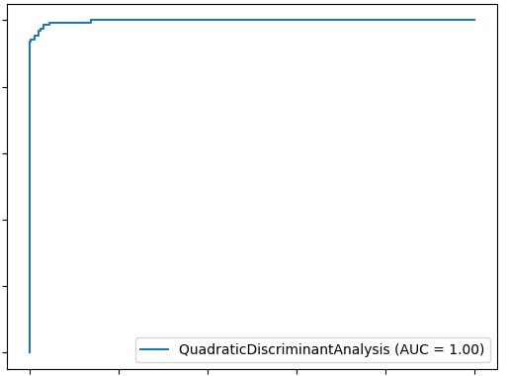
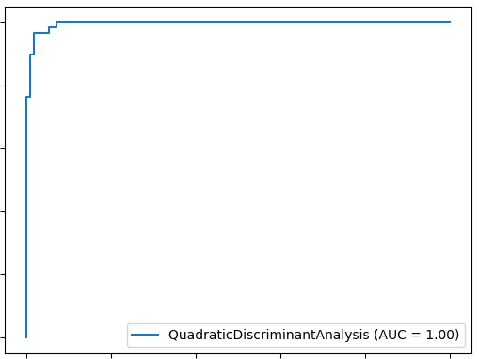
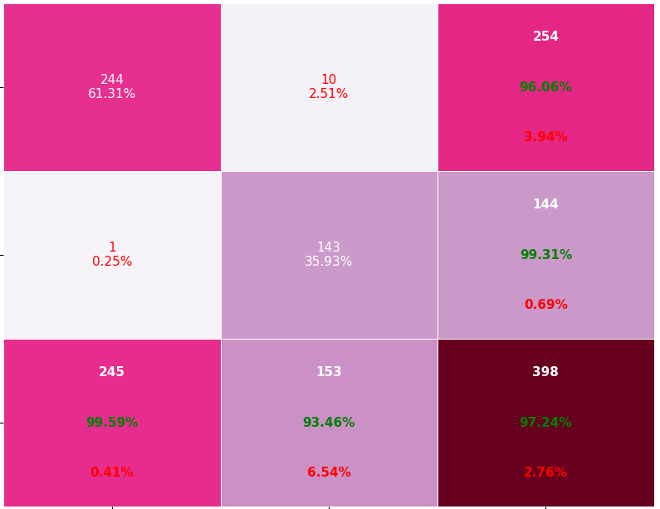

Roc and Classification matrix for QDA
Training:
Testing:

Slide 19
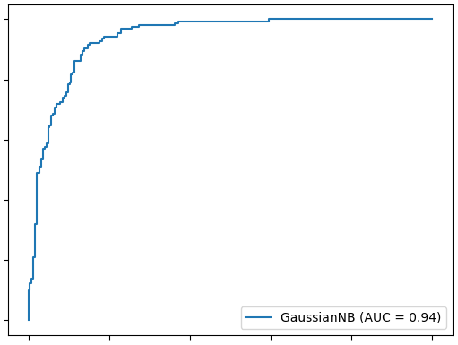
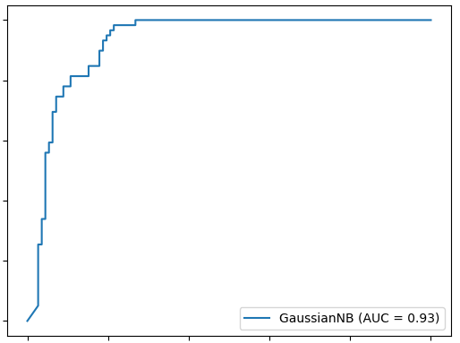
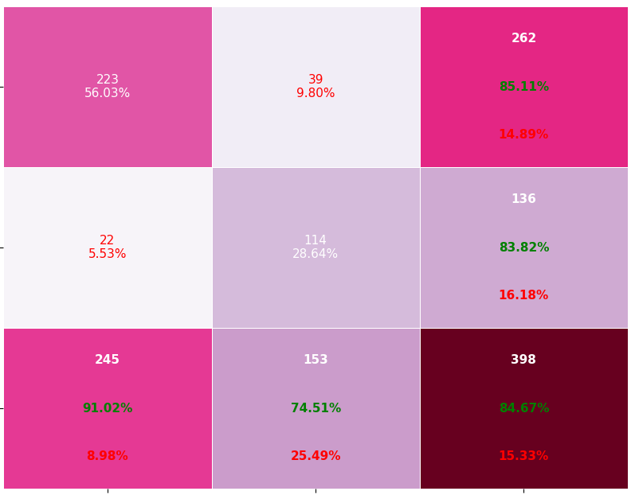
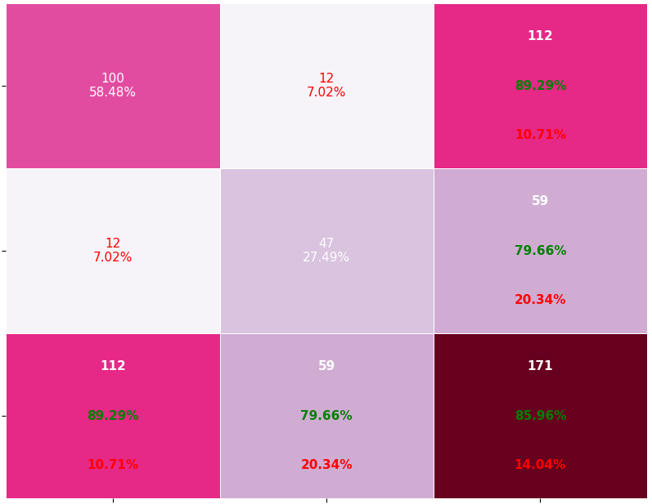
Roc and Classification matrix for DQDA
Training:
Testing:

Slide 20
TASK2 Observations
Below are the observations drawn from 99% variance and 99.9% variance outcomes:
For LDA and QDA the AUC’s(testing) are approximately equal and hence almost both performs well .
Also, from AUC’s(testing),DLDA performs well when compared to DQDA ,as the dimensions are reduced ie features are reduced
Although the sample size is same here, features got reduced ,hence comparatively performance of DQDA is reduced when compared to Task1.
Even from confusion matrices, we can say that comparatively performance of DQDA is reduced when compared to Task-1
Model performance of Task2 is comparatively less due to feature reduction but overall it also good with no huge differences in outputs

